Slide 1
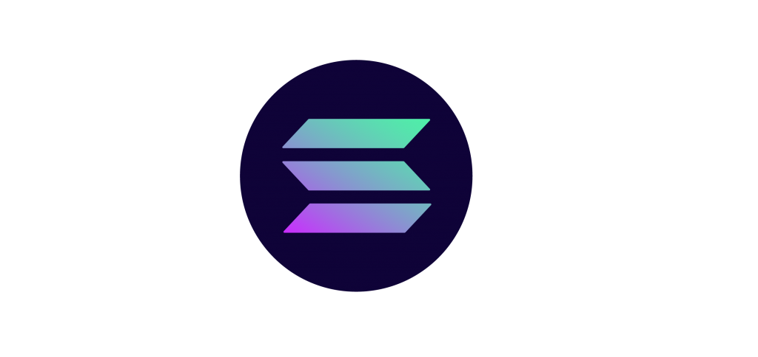
SOL
ANA

Slide 2
Team Members
01
02
03
04
05
2200719010009
Pritesh Bhatiya
2200719010011
Harsh Bhatt
2200719010020
Ankit Chavda
2200719010063
Bhavin Padiya
2200719010075
Miral Savera

Slide 3
01
Topics to be covered…
02
03
04
05
Introduction & History
Solana Smart Contract
Solana Marketplace
Features
Solana v/s Other BlockChain network

Slide 4
01
Introduction &
History

Slide 5
What is Solana?
Solana is a high-performance blockchain platform designed to enable decentralized applications and marketplaces.
The project was founded in 2017 by Anatoly Yakovenko, a former engineer at Qualcomm.
He is built on a unique consensus algorithm called Proof of History (PoH) ,which is a version of proof-of-stake (PoS).
Because of this, the Solana network can theoretically process over 710,000 transactions per second (TPS) without any scaling solutions needed.

Slide 6
More knowledge about Solana
Solana's native cryptocurrency is SOL, which is used to pay transaction fees and for staking.
transaction fees of solana is 0.000005 SOL and which is very low.
Solana uses a 256-bit secure hash algorithm (SHA-256) for generating hash.
Developer can deploy application on this platform.
Solana’s third-generation blockchain architecture is designed to facilitate smart contracts and decentralized application (DApp) creation.
The project supports an array of decentralized finance (DeFi) platforms as well as nonfungible token (NFT) marketplaces.

Slide 7
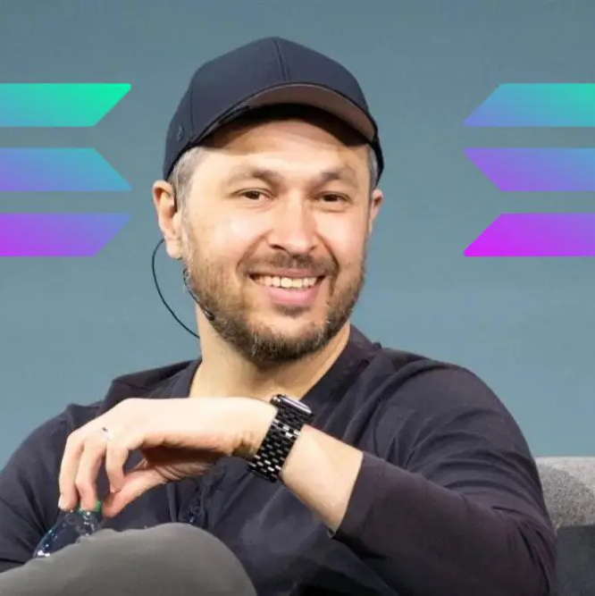
—Anatoly Yakovenko
“I can’t imagine a world where Solana succeeds because eth2 fails”

Slide 8
What is Proof of History(PoH)?
Proof-of-History also known as A Clock Before Consensus
Nodes in a distributed network cannot trust the timestamp on messages received from other nodes, the biggest problem in distributed networks is agreeing on the time and order in which events happen.
Solana uses Proof of History (PoH) to overcome this problem by establishing a cryptographically safe source of time throughout the network..

Slide 9
Why Proof of History is useful
Here’s a very unrealistic analogy to better explain it. Imagine we lived in a world where proposing to your partner was done by mail. You send a letter to your partner asking them to marry you. They get your letter and are overwhelmed, they write back denying your request.
A few days later, they have a change of heart and write back accepting your proposal. Unfortunately, both letters are stuck in the mail and you receive the acceptance first, and the rejection second. The miscommunication is problematic as you can see. You would have to connect at some point to clarify the misunderstanding. Adding PoH essentially adds a date to all of these letters so regardless of the order received, the understanding is clear.

Slide 10
How Proof Of History works?
A PoH generator node produces a new hash every few milliseconds, with each new hash being linked to the previous one in a chain.
Each hash contains a timestamp, a reference to the previous hash, and a random number called a "banking hash."
The banking hash is used to generate a unique signature for each block that is added to the Solana blockchain.
Solana validators can then use the PoH sequence to verify the order of transactions and reach consensus on the state of the network.

Slide 11
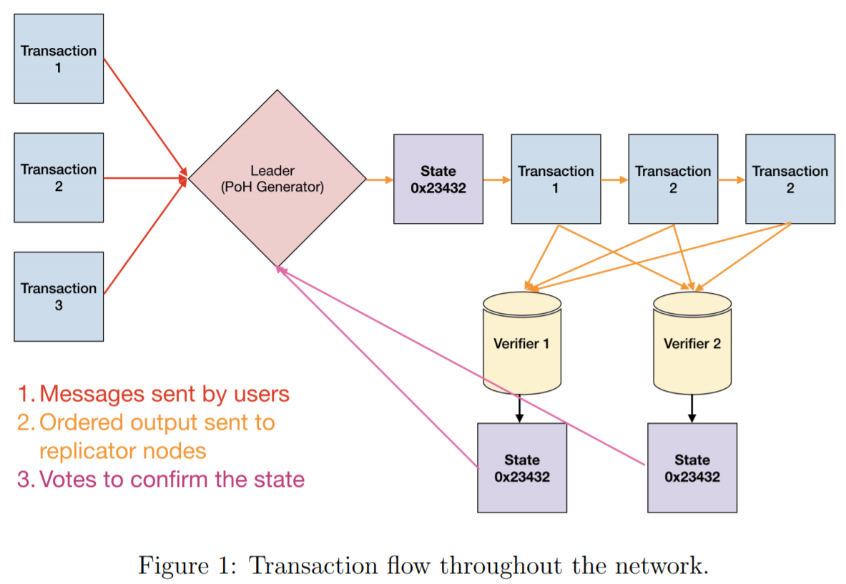
Transaction flow of Solana Network

Slide 12
Transaction flow of Solana Network
All Solana validators have the same computational power. The network will randomly select one validator and make them the leader.
All the other validators become verifiers.
The leaders’ job is to order all the transactions
With the high-spec computers used as validators, such an operation is easy and quick to do.
Once the leader has ordered the transactions, they broadcast the order of transactions to all the verifiers.
The leader then carries out the transactions. Next, the verifiers confirm all the transactions carried out by the leader in the next block.

Slide 13
02
Smart Contract

Slide 14
What is Smart Contract?
A Smart Contract in Solana is a Self-executing program that is deployed on Solana BlockChain.
It is a computer program that runs on the Solana network and is executed automatically when certain conditions are met
Smart Contracts are written in programming languages like Rust, Solidity Or C, and they are designed to facilitate, verify, and enforce the negotiation and performance of contracts.

Slide 15
Advantages of Developing Smart Contract On Solana
High Speed
Low Cost
Minimum Network Congestion
Environment-Friendly
Greater Transparency & Security
Enhanced Scalability

Slide 16
Solana Smart Contract Architecture
Smart Contract development and dApps development are two different types of development workflows of solana.
Smart Contracts, also called programs, are deployed on chain and run with the feature called “Solana Runtime”.
Solana comes with a completely different smart contract model when compared with traditional EVM-based Blockchain.
The code and state are combined into a single contract in case of conventional Blockchains whereas smart contracts are stateless and contains just program logic in the case of Solana.

Slide 17
Solana Smart Contract Architecture
Smart Contracts deployed on Solana can be accessed by external accounts that interact with the program to store data related to program interaction.
In this way, the logical separation of contract code and states takes place that differentiates Solana Smart Contract Development from EVM-enabled Blockchains.
In order to enhance interaction with dApps, Solana also comes with Command Line Interface (CLI) and JSON RPC API.
dApps can also interact with the Blockchain and Solana programs using existing SDKs.

Slide 18
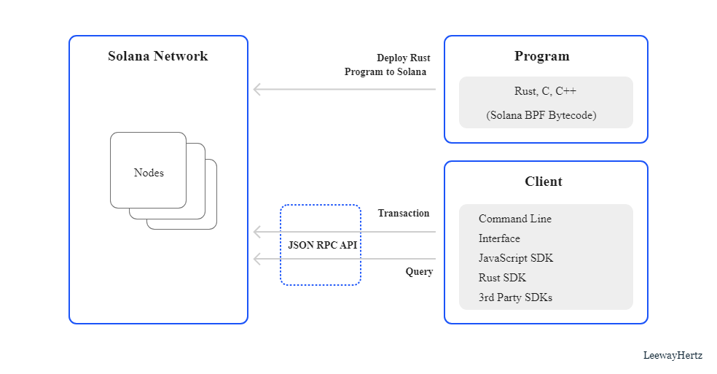
Solana Smart Contract Architecture

Slide 19
WorkFlow Of Architecture
In the above diagram, the section “Program” enables users to create smart contracts with Rust, C, and C++ and deploy them on the Solana Blockchain.
After completing the Solana Smart Contract Development, users must develop dApps with the help of client SDKs and JSON RPC API to use Solana Programs.
The Section “Client” allows users to create decentralized apps to interact with deployed programs. Decentralized apps will interact with deployed programs by submitting transactions via client SDK.
Both “Program” and “Client” will work together to form a network of decentralized applications and smart contracts that can interact with each other to update the state of Blockchain.

Slide 20
03
Solana Marketplace

Slide 21
Solana is a high-performance blockchain platform that supports a variety of decentralized applications, including marketplaces. There are several marketplaces that have been built on Solana, including:
Solanart:- A digital art marketplace that allows creators to mint and sell their works as NFTs (Non-Fungible Tokens) on the Solana blockchain.
The first marketplace on Solana to buy, trade and sell non-fungible tokens (NFTs).
Solanart is an NFT marketplace hosted on the Solana blockchain
Solana's fast transaction times and low fees to create a seamless experience for both creators and buyers.

Slide 22
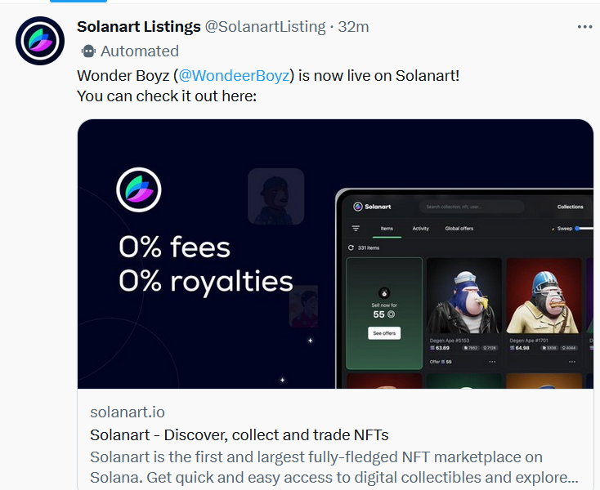
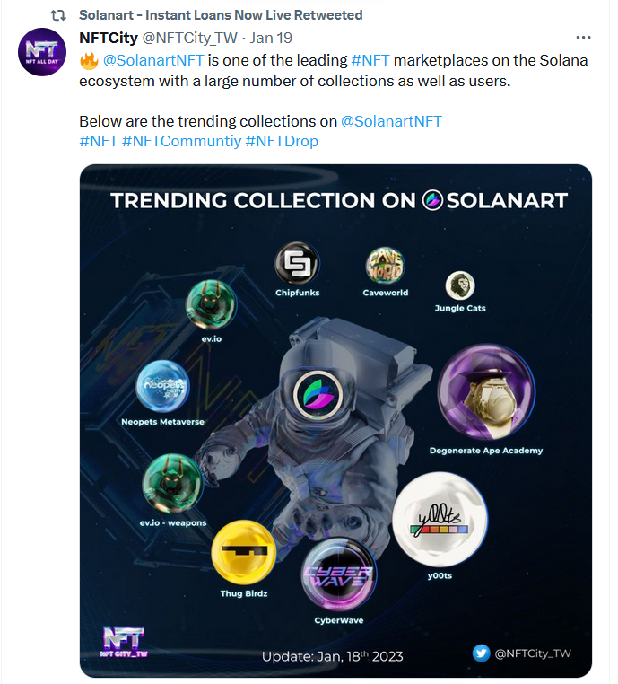

Slide 23
2.Magic Eden: A platform that allows users to buy and sell unique digital items, including NFTs, on the Solana blockchain.
The platform was created to address the need for a more user-friendly and accessible NFT marketplace on Solana.
One of the unique features of Magic Eden is its focus on curation. The platform only allows high-quality and unique digital items to be listed for sale.
which helps to ensure that buyers can trust the authenticity and value of the items they purchase.
Buyers can browse the marketplace and purchase NFTs using their Solana wallet.

Slide 24
3.Solsea: Solsea is a decentralized exchange (DEX) built on the Solana blockchain. It allows users to trade cryptocurrencies and other digital assets in a trustless and decentralized manner, without the need for intermediaries like centralized exchanges.
The platform was created to address the need for a more user-friendly and accessible NFT marketplace on Solana.
Another important feature of Solsea is its integration with other decentralized finance (DeFi) protocols on the Solana network.
The liquidity on Solsea is provided by liquidity providers who earn a portion of the trading fees as rewards.

Slide 25
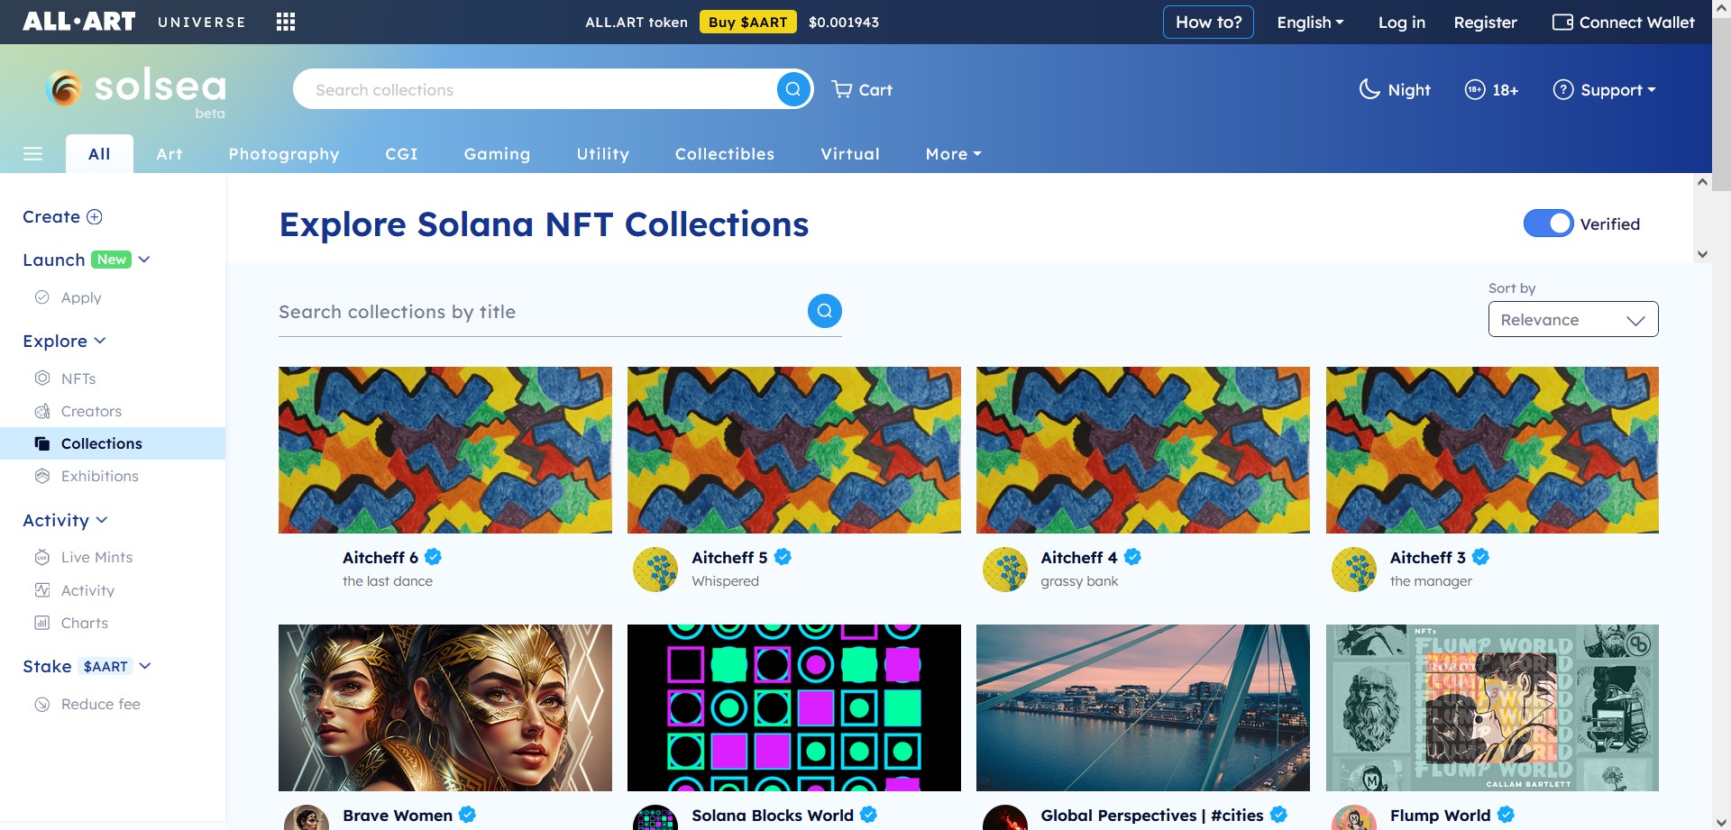

Slide 26
4 DigitalEyes : It is a free and open platform for anybody to utilize on DigitalEyes, the most popular NFT collections are Aurory, Degenerate Ape Academy, Frakt etc.
Phantom, Sollet, Solflare, Solong, Slope, and MathWallet are among the wallets that DigitalEyes supports.
There is a 0.99 percent service fee charged by DigitalEyes on every successful NFT transaction.
It is necessary to charge the buyer of the NFT two additional fees: a royalty fee specified by the inventor and a service cost.

Slide 27
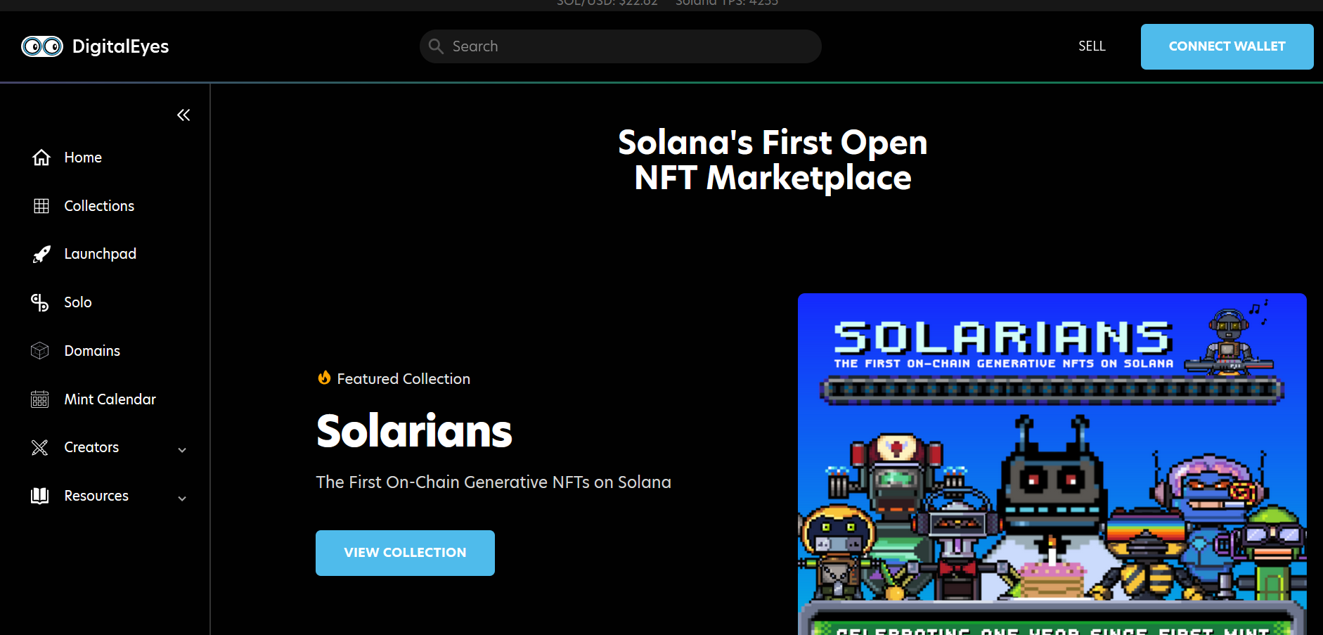

Slide 28
5 Raydium : Raydium is an open-source DeFi (Decentralized Finance) platform built on the Solana blockchain.
It provides a suite of decentralized trading and liquidity protocols for users to trade various tokens with high-speed and low transaction fees.
Raydium's platform includes features such as automated market making, liquidity pools, and yield farming to enable users to earn rewards for providing liquidity and participating in the platform's governance.
Raydium also has its own token, called RAY, which can be used for staking and voting on governance proposals.

Slide 29
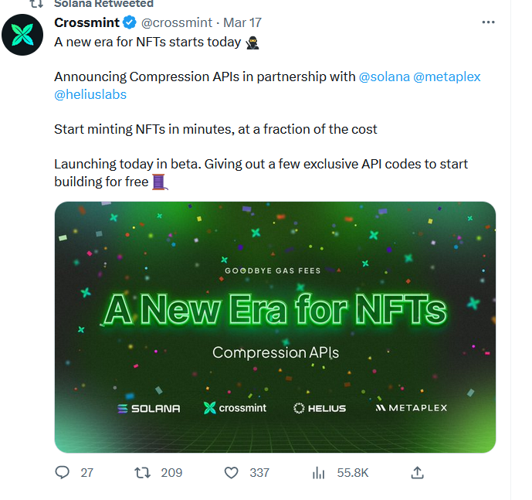
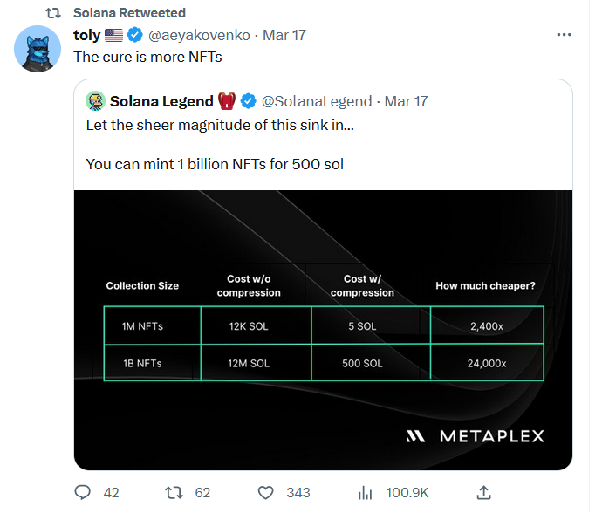
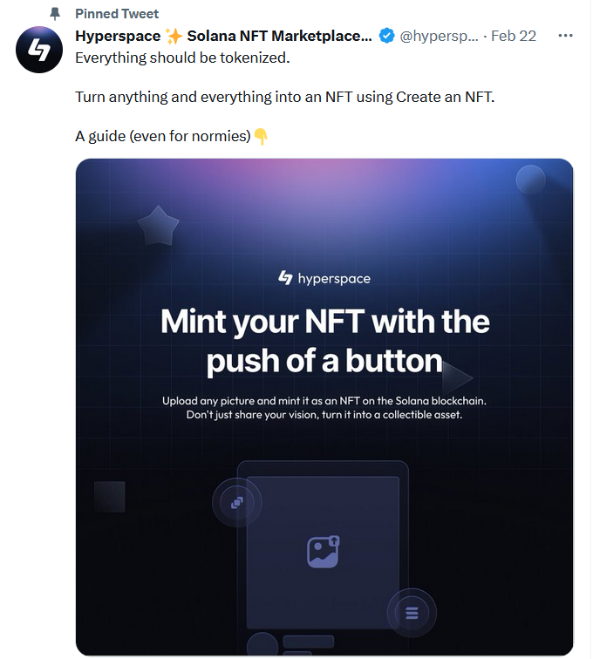
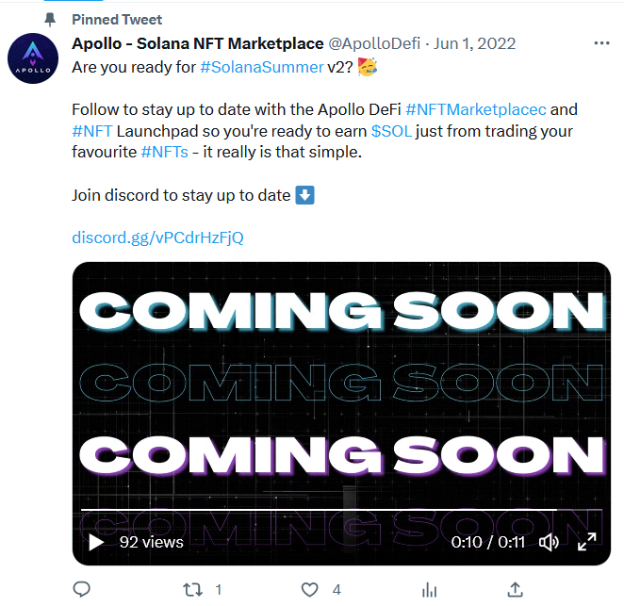

Slide 30
04
Features

Slide 31
Features
01
02
Open Source Code
SOL
04
03
Layered Services
Horizontal Scaling
05
06
Turbine Protocol
Leader nodes on rotation
07
Miniscule block times

Slide 32
Open Source Code
SOL
Like many other blockchains, Solana has an Open Source application.
That means anyone can download the source code and implement it for personal and commercial use.
https://github.com/solana-labs/solana
Solana’s native currency is Solana or simply SOL.
SOLs are also available in smaller denominations called Lamports.
Lamport's are named in honor of the famous American computer scientist Leslie Lamport who is known for his important work on distributed systems and computing efficiency.

Slide 33
Layered Services
Solana uses several services on top of the network to improve efficiency. Think of it like a technology stack where different layers perform a specific function.
With these services, Solana can be used to build decentralized applications (Dapps) and Decentralized Financial Institutions (DeFis)

Slide 34
Horizontal Scaling
Horizontal scaling, which allows it to add more computers to its processing network to distribute computing resources.
Tasks can be processed by multiple computers running in parallel to take true advantage of distributed resources.
The network can also connect seamlessly between CPUs, SSD, and GPUs at the hardware level.
Here are some of the distributed systems within Solana.
Gulfstream, Cloudbreak, Sealevel

Slide 35
Turbine Protocol
Leader nodes on rotation
Solana uses the Turbine protocol to transmit information in smaller pockets to nearby node clusters called neighborhoods.
This allows it to validate transactions faster.
Leader nodes are nodes that are expected to validate transactions within a cluster.
A single node is assigned to be a leader by the network. This increases efficiency within a node cluster.

Slide 36
Miniscule block times
Solana has a 400ms block time.
Short block times make transactions extremely fast and allow it to easily process thousands of transactions per second.
https://solanabeach.io/

Slide 37
05
Difference Between Solana & Other Blockchain Networks

Slide 38
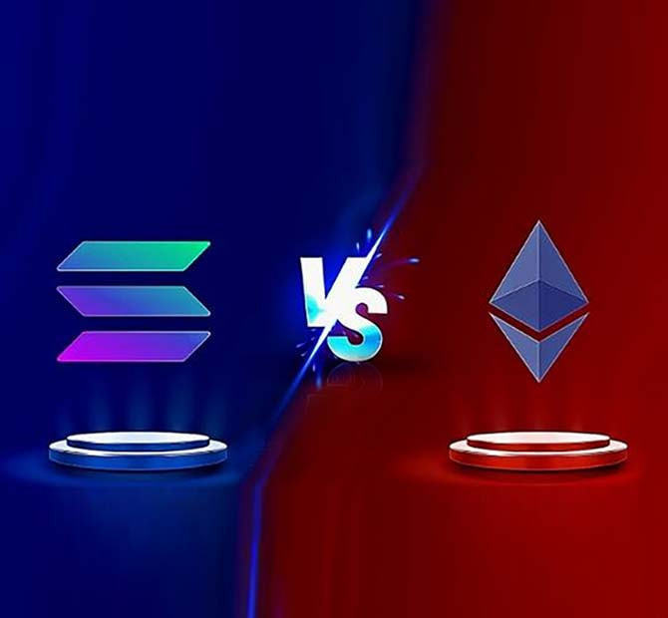
Solana Vs Ethereum
Solana and Ethereum are both blockchain platforms that support smart contracts and decentralized applications (dApps).
But they have some different types of features.
Following are some of the key differences between Solana and Ethereum:
Scalability :
Solana claims to have a significantly higher transaction processing capacity than Ethereum.
Solana Transaction Speed is 65,000 transactions per second
Ethereum's current throughput is around 15 transactions per second.

Slide 39
Solana Vs Ethereum
Consensus mechanism :
Ethereum uses Proof of Work (Pow) consensus mechanism, which is energy-intensive and slow.
whereas Solana uses a Proof of History (PoH).
Transaction fees :
Solana's transaction fees are generally lower than Ethereum's fees, due in part to its faster transaction processing times.
Programming Languages :
Solana is designed to be compatible with the Rust programming language, while Ethereum supports Solidity.
Tokenomics :
Solana has its own native cryptocurrency, called SOL, while Ethereum has two native cryptocurrencies, Ether (ETH) and Wrapped Ether (WETH).

Slide 40
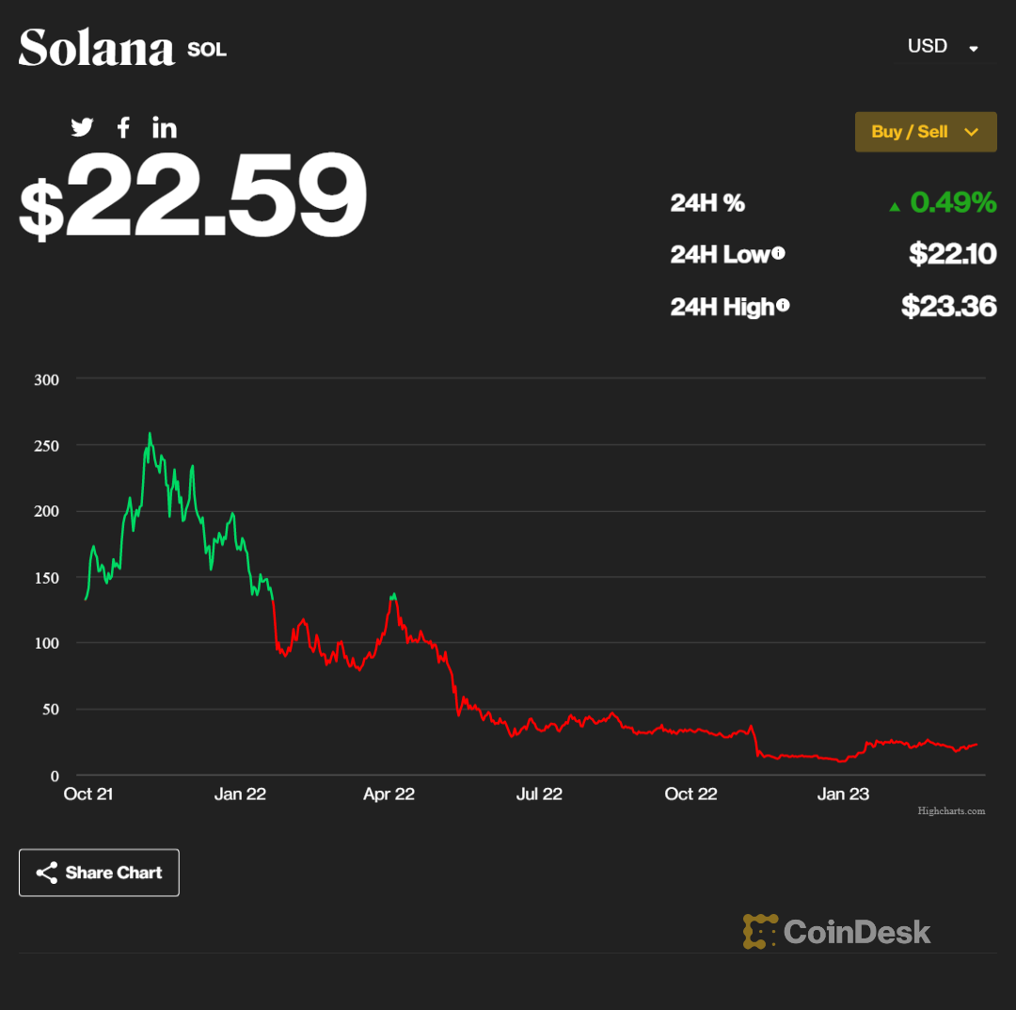
Solana Vs Ethereum
Solana Price History

Slide 41
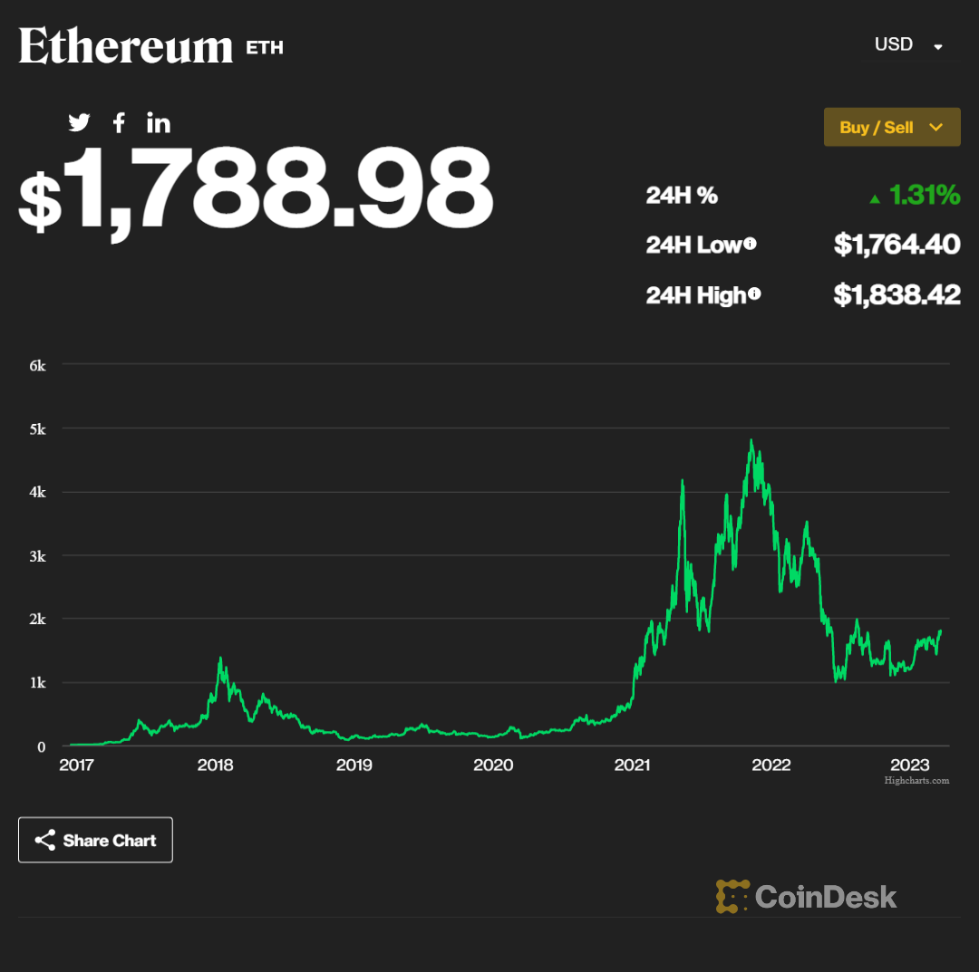
Solana Vs Ethereum
Ethereum Price History

Slide 42
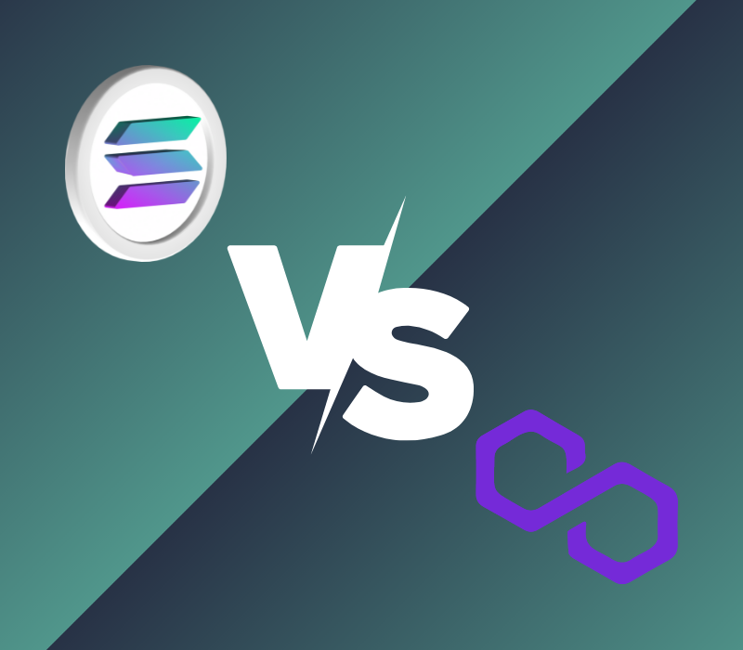
2. Solana Vs. Polygon
Solana and Polygon are both blockchain platforms that aim to provide solutions to Ethereum's scalability issues.
But they have some key differences in terms of their design and features.
Following are some of the key differences between Solana and Polygon :
Scalability :
Solana has a higher transaction processing capacity than Polygon
Polygon's current throughput is around 7,000 transactions per second and solana 65,000 transaction Per Second.

Slide 43
Solana Vs. Polygon
Consensus mechanism :
Polygon uses a variant of PoS called Proof of Stake (PoS) commit chain.
Solana uses a combination of Proof of History (PoH) and Proof of Stake (PoS).
Programming Language :
Polygon supports Golang, Solidity, Vyper programming language, and Solana supports Rust and C languages.
Transaction Fees :
Solana and Polygon offer very low transaction fees compared to other blockchain networks. Solana's transaction fee is around $0.00025,
while Polygon's fees average transaction fee is around $0.00002.
Tokenomics :
Solana has its own native cryptocurrency, called SOL.
while Polygon has native cryptocurrency, MATIC.

Slide 44
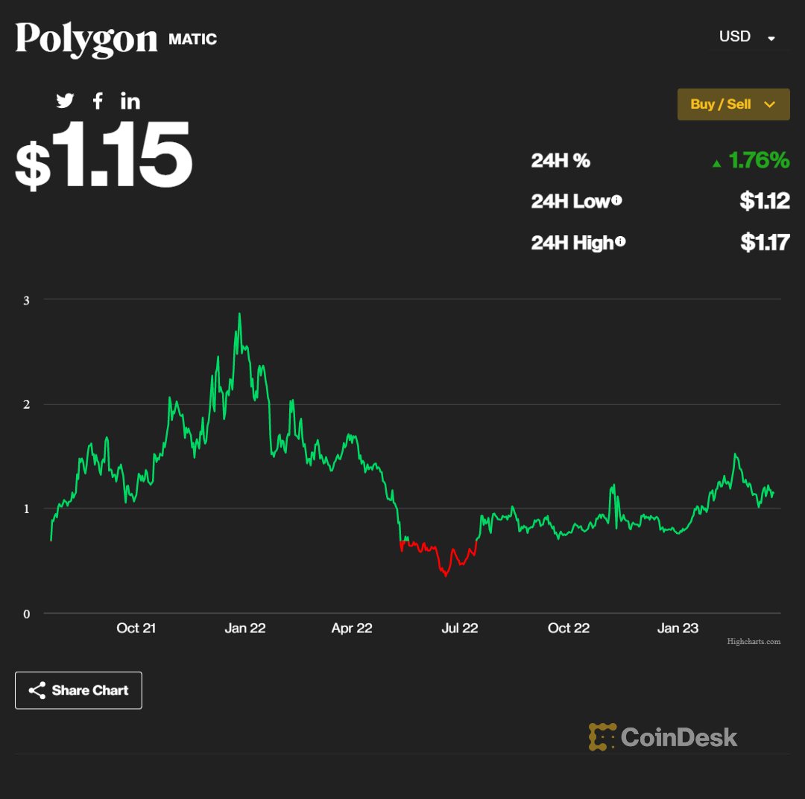
Solana Vs. Polygon

Slide 45
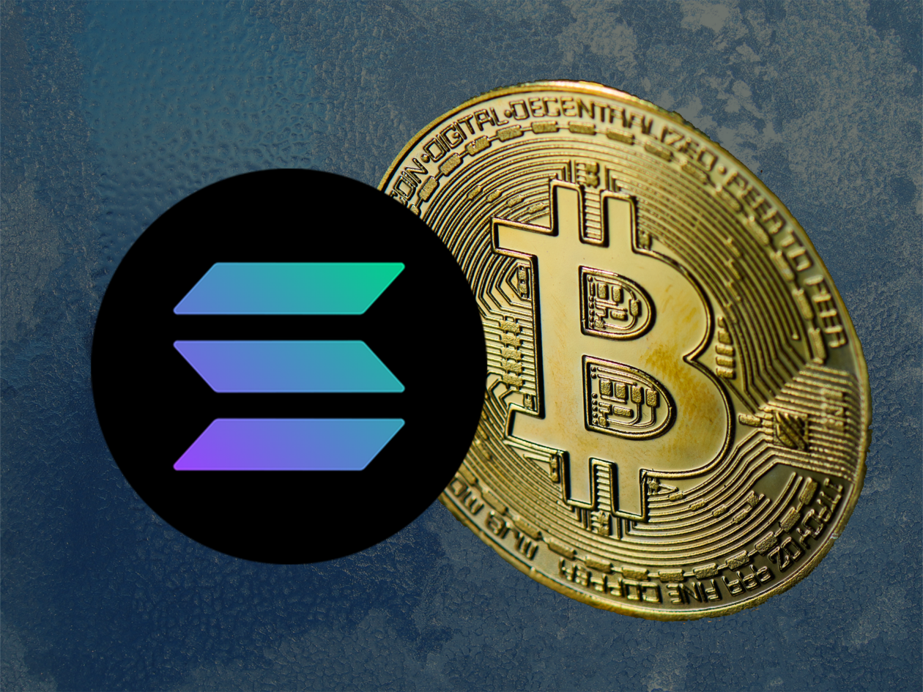
3. Solana Vs. BitCoin
Solana and Bitcoin are both cryptocurrencies.
But they have some fundamental differences in terms of their design, features, and goals.
Following are some of the key differences between Solana and Bitcoin :
Scalability :
Solana has a significantly higher transaction processing capacity than Bitcoin
Consensus mechanism :
Bitcoin uses the Proof of Work (PoW) mechanism.
Solana uses a of History (PoH) and Proof of Stake (PoS).

Slide 46
Solana Vs. BitCoin
Transaction fees :
Solana's transaction fees are generally lower than Bitcoin's fees, due in part to its faster transaction processing times.
Use cases:
Solana is designed to support decentralized applications (dApps) and smart contracts, while Bitcoin is primarily used as a store of value and a means of payment.
Transaction Speed :
Solana's transaction speed is significantly faster than Bitcoin's transaction speed.
Bitcoin can only process around 7 transactions per second,
while Solana’s transaction processing capacity of up to 65,000 transactions per second

Slide 47
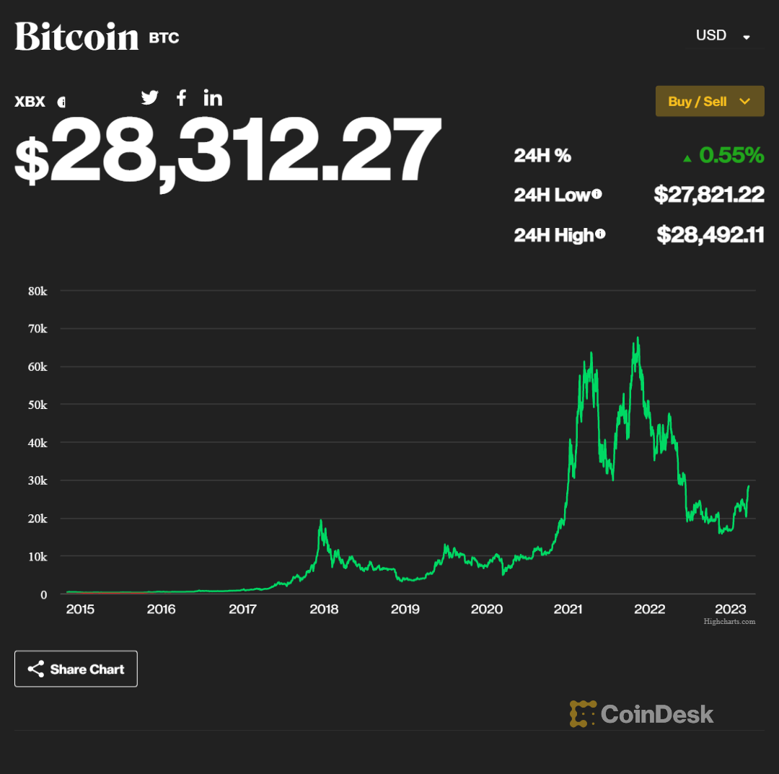
Solana Vs. BitCoin

Slide 48
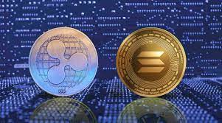
4. Solana Vs. Ripple
This both are blockchain platform,provide solution to traditional financial system
But both are different in feature,goal and design
Following are some of the key differences between Solana and Ripple :
Scalability :
Ripple's current throughput is around 1,500 transactions per second, while Solana Transaction Capacity 65,000 transactions per second.
Tokenomics :
Ripple has its own cryptocurrency, called XRP.
Solana has its own native cryptocurrency, called SOL.

Slide 49
Solana Vs. Ripple
Consensus mechanism :
Ripple uses its own unique consensus mechanism called the Ripple Protocol Consensus Algorithm (RPCA).
Solana uses a Proof of History (PoH) and Proof of Stake (PoS).
Use cases :
Ripple's primary focus is on providing solutions for cross-border payments and remittances
While Solana is designed to support decentralized applications (dApps) and smart contracts.

Slide 50
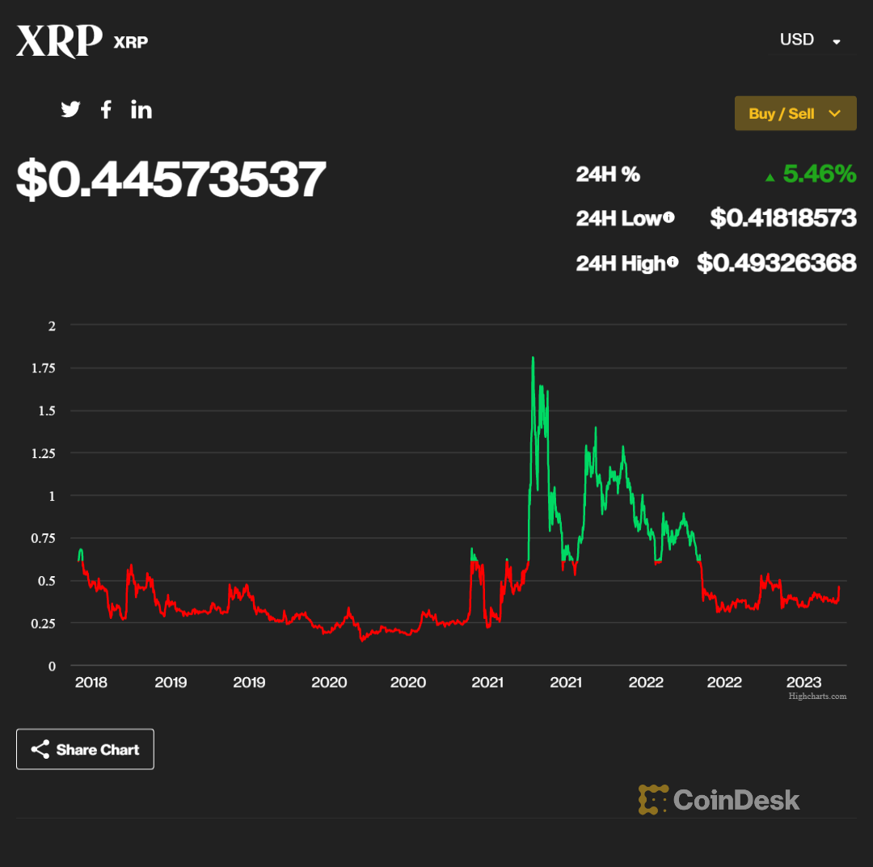
Solana Vs. Ripple

Slide 51
Thanks!

